Slide 1
P R E S E N T E D B Y

Slide 2
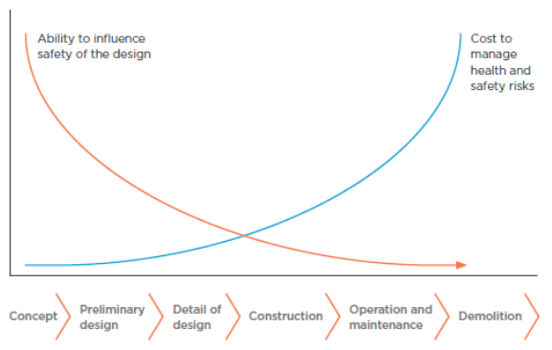
Safety Moment – HSE In Design
WHAT IS HSE IN DESIGN?
Managing and proactively reducing HSE risks for the lifecycle of the equipment through intelligent design in the early phase.
HSE focus not only on the functional design, but also on the lifecycle of the equipment and the way it will be used, typically:
WHY IS THIS IMPORTANT?
Can prevent unforeseen negative consequences for engineering and construction projects and can:
Reduce work place ill-health and injury
Reduce equipment and facilities damage
Reduce redesign and retrofitting of safety mitigations
Reduce cost and schedule impacts from future reworks
Reduced need for protective equipment, health & exposure monitoring
Improved health and safety brings improved wellbeing and productivity
Fabrication
Assembly
Transport/shipping
Testing
Installation
Operation
Maintenance
Storage
Disposal/recycle
WHY IS THIS APPLIED IN THE EARLY PHASE OF DESIGN?
Equipment changes in response to incidents – a reactive approach – can reduce the safety margin on equipment, particularly if the equipment is unusual or novel.
HSE IN DESIGN CHECKLIST
Ensure HSE in design process is planned and documented, with intervention points highlighted and potential gaps filled
Lessons learnt from similar equipment are included
Identify equipment specific risks and address them
Check novel aspects to ensure risks are fully understood
Identify deviations from accepted standards and address them
Ensure lifecycle risks are considered, including how easily the equipment will be maintained and operated.
Internal/external interface risks considered and minimised
The ability to influence safety is cheapest and most efficient in the early phase!

