Slide 1
P R E S E N T E D B Y

Slide 2
Safety Moment – Cycling (Norway)
WHY SHOULD WE CYCLE?
Improves mental wellbeing (ref. study by YMCA)
Strengthens upper respiratory system/immune system (ref. Appalachian State University study)
Promotes weight loss (consumes calories)
Strengthens leg muscles
Improves lung health (ref. Healthy Air Campaign study)
Cuts heart disease and cancer risk (ref. University of Glasgow study)
Low impact training therefore kind to the joints
Cycle to work and cut cost, pollution and congestion
Cycling improves sleep (ref. University of Georgia study)
Cycling (exercise) improves brain power (ref. Blood Flow Metabolism study, Dec 2013)
Cycling can be sociable!
WHAT THE LAW SAYS…(*)
On the road: The same rules as cars apply
On the path:
Only when there are few pedestrians
Providing its not a danger or hinderance to pedestrians
Not faster than walking pace
Forbidden to cycle:
On motorways and slip roads
In some tunnels marked with no cycling signs
WHY IS CYCLE SAFETY IMPORTANT?
Cyclists make up approximately 5% of the traffic
Cyclists responsible for 50% of personal injuries on the road
Oslo university hospital treated:
41 cyclists in 2001
194 cyclists in 2015 (Ref. motor.no, 2017)
(*) Always check the current laws

Slide 3
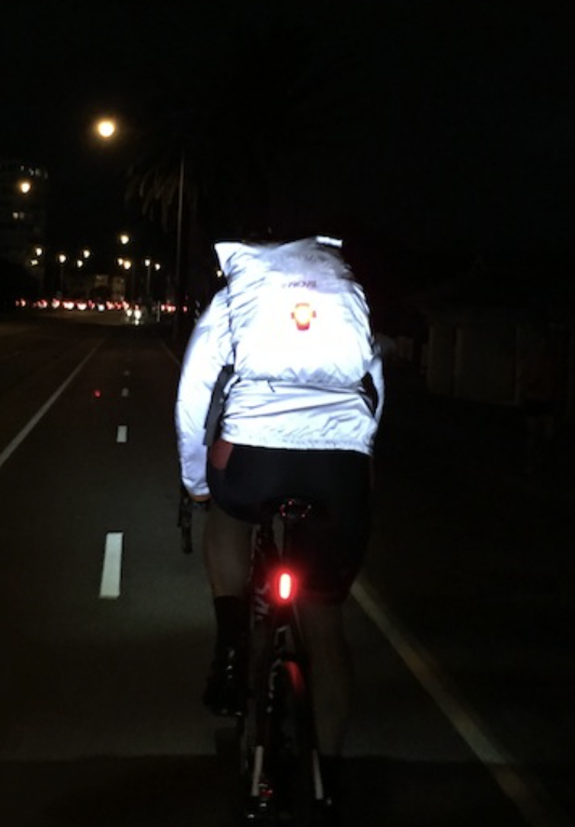
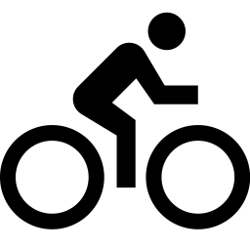
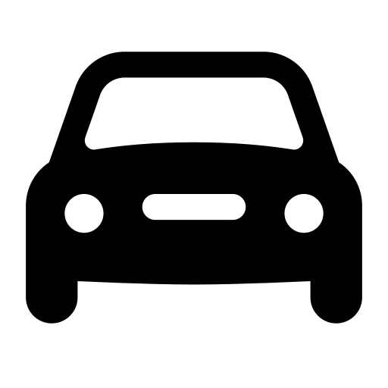
Safety Moment – Cycling (Norway)
RIDE SAFELY
Good road position not too close to the roadside / curb
Improves visibility to drivers and gives more wiggle room
Always be aware of the traffic and traffic situation around you
Anticipate mistakes by drivers and other road users
Drivers turning left or waiting to pull out from a side road may not have seen you
Make your intentions clear, check behind, give clear hand signals
Make eye contact - helps you anticipate drivers intentions
Never undertake a lorry, they can´t see you!
Parked cars with people inside – anticipate the door opening
Keep hands covering the brakes in congested areas
YOUR PERSONAL SAFETY ON A BIKE
ALWAYS wear a correctly fitting helmet
Wear bright hi-viz colours to help you be visible in traffic
Wear sports glasses to protect eyes against dust and insects
Always use lights at night, in low light conditions or in rain
Wear reflective clothing in low light or at night.
SPECIFIC DANGERS FOR YOU TO LOOK OUT FOR
T-junctions: Motorist pulls out in front of cyclist
Roundabouts: Similar to T-junctions, watch for cars pulling out
Parked vehicles: allow a bit more clearance particularly if vehicles are occupied
Overtaking: Caution in stationary traffic – drivers don’t naturally check for bikes when moving or changing lanes
Potholes and debris

