Slide 1
P R E S E N T E D B Y

Slide 2
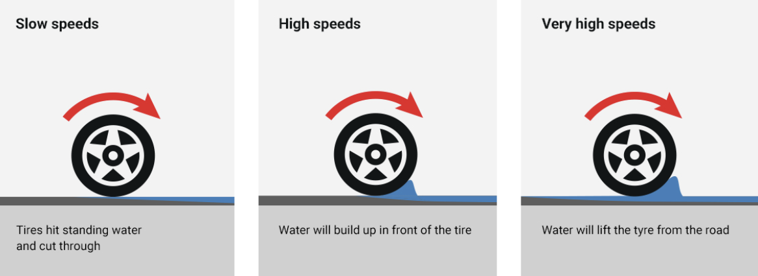
Safety Moment – Tyre Safety (Norway)
THE LAW*
Tread depth winter 3mm (NAF recommend 4mm).
Tread depth summer 1.6 mm (NAF recommend 3mm).
AQUAPLANING
Factors:
Speed
Wet road
Surface of the road – worn grooves
Tread wear & tyre pressure
Tread design - winter tyres are worse than summer tyres!
* Always check current law
CHANGING WHEELS YOURSELF
Do you have the right tools? Rating of jack and torque wrench, axel stand or support, PPE, level area etc.
Can you handle the large wheels alone? Do you need help? Common cause of back injury.
Watch for pinch points.
NEVER work under a car supported by a jack only.
TIPS
Using a workshop:
Check that they use a torque wrench.
Check that air impact wrenches are calibrated – difficulty removing wheel manually in case of roadside puncture.
Typical torque is 100 Nm (check for your car). This equates to 20 kg on a 50 cm lever.
ALWAYS re-check wheel nut torque after 50 km of driving.

